Slide 1
SWOT Analysis
Strengths, Weaknesses
Opportunities, Threats

Slide 2


Slide 3
How?
Improve operational efficiency
Maximize profit
Constant improvements in everyday systems
SWOT analysis is a great start!

Slide 4
SWOT Analysis
Critical self-analysis of a business.
Highlights factors that a business should consider when planning for the future.
Comprehensive overview of a company.
Strategic plan emerges!

Slide 5
SWOT Analysis
Past ≠ Future
Past successes are not a guarantee of future successes
Past failures do not have to be repeated

Slide 6
SWOT Analysis
Factors that affect long-term future and profitability of a business:
Capitalize on strengths and opportunities
Improve upon weaknesses
Reduce potential threats

Slide 7
SWOT Analysis
Strengths
Weaknesses
Opportunities
Threats
Do NOT want this equation to balance!

Slide 8
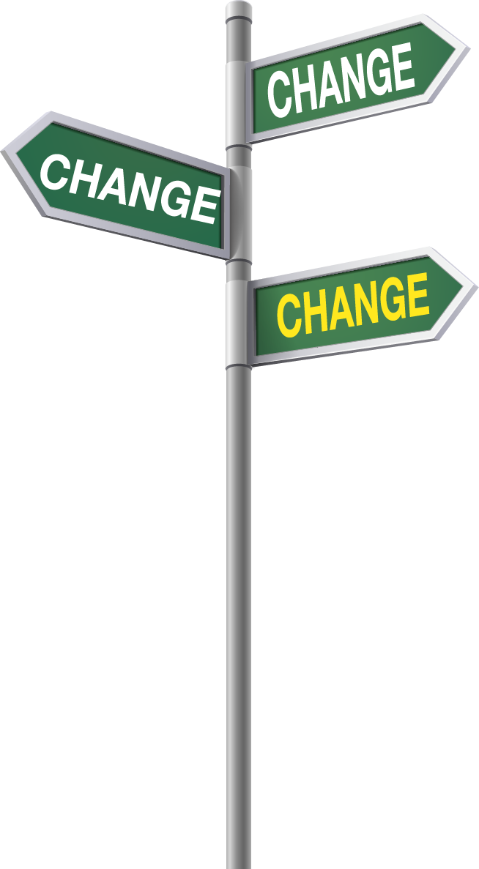
Business Constantly Changes
Don’t rest on past successes
Don’t dwell on past failures
Identify important elements in your business
Make changes....move forward!

Slide 9
Strengths
Internal resources, products, services, processes, etc. that a company does well
Enhances a company’s competitivenss in the market

Slide 10
Strengths - Examples
Specialized skills (makes company highly competitive relative to other companies)
Low-cost operation
Advanced technologies
High quality products or services
Fine-tuned supply chain management functions

Slide 11
Strengths - Examples
Research/development/introduction of new and/or innovative products
First to market with new products
Specialized expertise

Slide 12
Strengths - Examples
Assets, equipment, and/or facilities
Technologically advanced equipment
Location
Modern warehouse and/or distribution facilities
Capacity to grow

Slide 13
Strengths - Examples
Human capital
Depth of management
Experienced, long-term employees
Highly motivated & competent employees

Slide 14
Strengths - Examples
Intangible assets
Marketing & selling superiority
Broad base of customers (loyal & long-term)
Broad base of suppliers (quality, service, price competitive)
Recession-proof business (as much as possible)

Slide 15
Strengths - Examples
Nonseasonal business
Branded name
Internal and organizational assets
Financial strength and resources
Excellent customer service and support
Proprietary assets

Slide 16
Weaknesses
Internal resources that a company does not so well or completely lacks
Contributes to a company’s competitive disadvantage or deficiencies

Slide 17
Weaknesses - Examples
Lack of expertise in the business field
Lack of employee talent, loyalty, longevity
Inferior and/or obsolute assets, equipment, facilities
Poor location
Ineffective marketing
No clear strategic direction

Slide 18
Weaknesses - Examples
Weak financial position and resources
High costs, low profits
No product or service innovations
Non-responsive customer service & follow-up
Narrow product or service line
Small customer base compared to competitiion

Slide 19
Market Opportunities
Untapped market opportunities
Major factor in company’s growth and profit
Must match strengths and opportunity to yield maximum profit

Slide 20
Market Opportunities - Examples
Expanding geographically or globally with existing products or services
Adding complementary products or services
Purchase a competitor
Diversify product or service offerings
Develop strategic alliance

Slide 21
Market Opportunities - Examples
Hire talented, skilled employees to enter new market and/or offer new product or services
Discover underserved markets and satisfy the needs of that market

Slide 22
Threats
External threats will always exist
Can hinder a company’s profitability and competitive edge
Foresee threats and mimimize effect if they materialize

Slide 23
Threats - Examples
Competition with cheaper or better product
Less expensive foreign imports
New taxes and/or business regulations
Increase in operating costs and/or interest rates
Shift in customer or supplier base

Slide 24
Threats - Examples
Larger company with more financial resources duplicating product or service
Tight credit market
Weak economy
Bargaining power of major customer that reduces profit

Slide 25
What Emerges from a SWOT Analysis?
A strategic plan for the future!
How do get started?
Blank sheet of paper
White board
Employee gathering

Slide 26
What's the goal?
CAPITALIZE
IMPROVE
Strengths/Opportunities
Weaknesses/Threats

Slide 27

Things to Remember!

Slide 28
Things to Remember!
SWOT is a work-in-progress
SWOT factors are always changing
List in each category can be short or quite endless

Slide 29
Things to Remember!
Accumulation of various strengths provide a competitive edge
Never dependent upon one person, product, service, or intangible asset
All strengths have synergistic effect that make a company valuable
Whatever strength a company has, another company will eventually try to imitate it

Slide 30
Things to Remember!
The more strengths a company has, the greater its ability to continue to grow and add to its strengths...a snowball effect
Regardless of a company’s strengths, it is competent people who drive an organization to achieve competitive superiority
Competitive disadvantages increase as the number and magnitude of weaknesses increase

Slide 31
Things to Remember!
All companies have weaknesses, but competitive advantage goes to the company that has more strengths than weaknesses
Perception of weaknesses is reality in the marketplace
Known weaknesses must be confronted as soon as possible to correct the deficiencies

Slide 32
Things to Remember!
Weaknesses that contribute most to a company’s competitive disadvantage must have priority and be corrected as soon as possible
The longer deficiencies exist, the greater the competitive disadvantage
Not all opportunities are realistic for a business to undertake
Internal resources must be present

Slide 33
Things to Remember!
Older threats might subside, but new threats will constantly emerge
A company must foresee external threats
Know in advance what action will be taken to minimize negative effects if threat materializes

Slide 34
Now What?
Draw conclusions about your company
Consider changes
Utilize strengths
Improve weaknesses
Capitalize on opportunities
Reduce potential threats

Slide 35

Gain a Competitive Edge!
SUCCESS
Solidify Strength in Marketplace!
Improve Profits!

Slide 36

Insert Name

